Slide 1
GROUP 5
Alice Baker and Beth Cowle

Slide 2
OVERVIEW
A platform for face-to-face social interaction
Non-Digital – Card Game
Voting
Bluffing/Deceiving
Hidden Information
4 – 6 Players
Simultaneous
Notes:
Alice

Slide 3
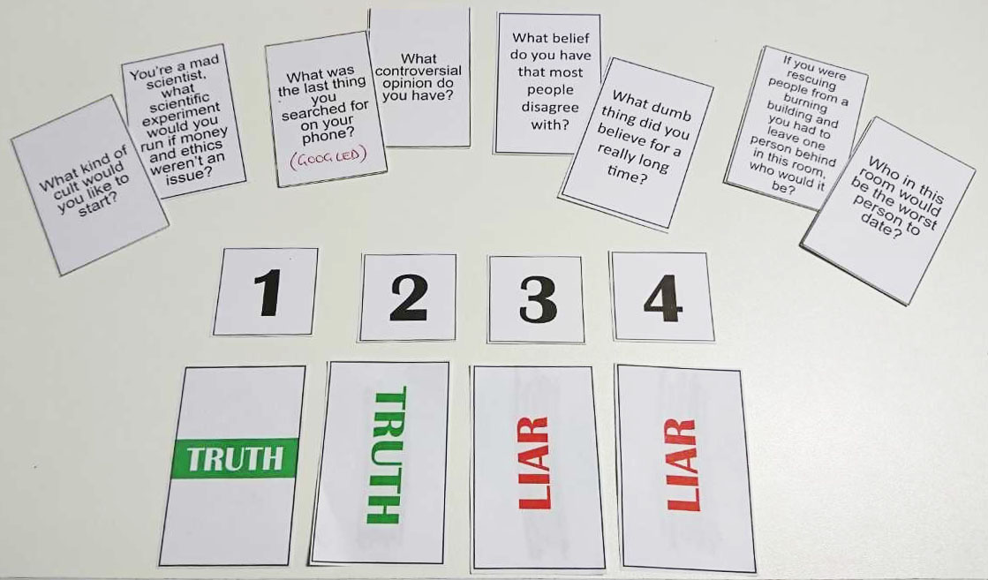
THE GAME
2 liars are selected at random
Players have to guess the liars correctly to score points
Liars receive 1 point for each player who doesn’t choose them
2 points for guessing the liar correctly
Notes:
Beth

Slide 4
Answer the question card
Points collected
Questioning players
Liars are revealed
Vote in secret
Reveal votes
Notes:
Alice

Slide 5
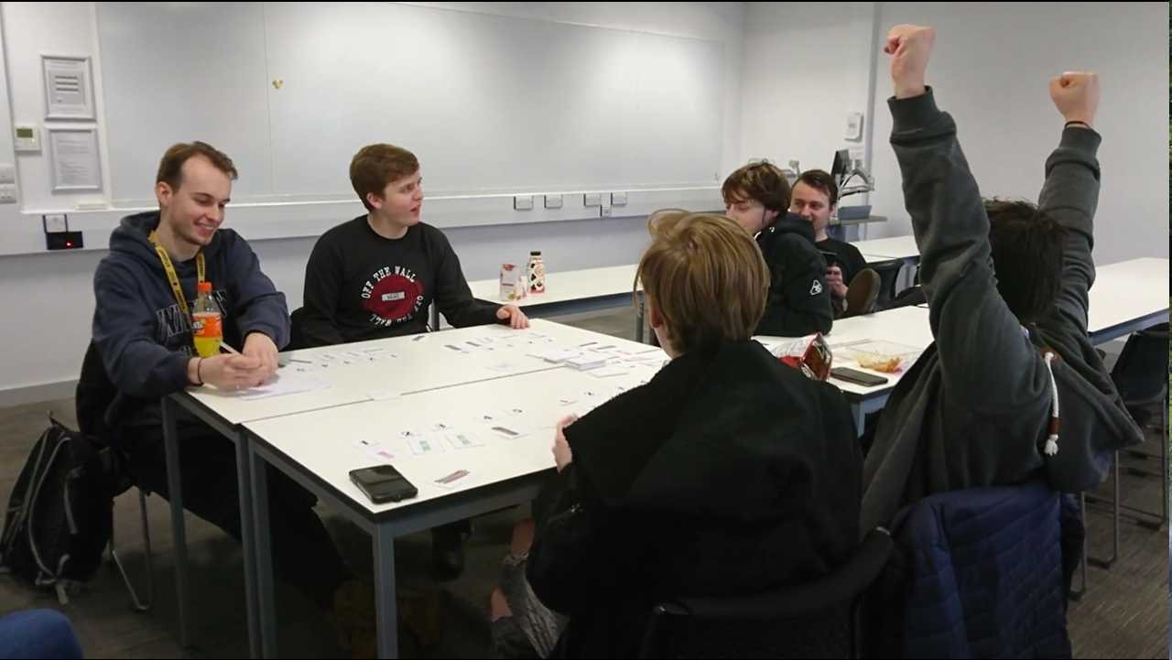
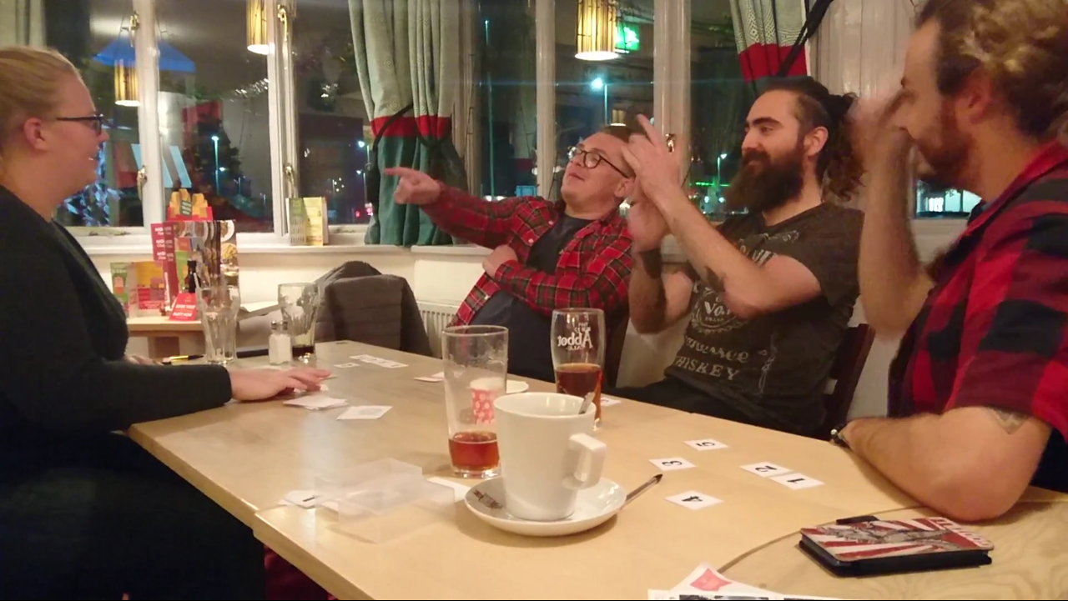
MECHANICS, DYNAMICS AND AESTHETICS
Mechanics | Dynamics | Aesthetics
4 – 6 players Voting Bluffing/deceiving Hidden Info Simultaneous | Communication Accusation Arguing Story telling Alliances | Laughter Tension Fiero Amusement Anticipation
Notes:
Beth

Slide 6
TARGET AUDIENCE
Male and Female
Ages 16 - 25
Casual Gamers
Social Players
Notes:
Alice

Slide 7
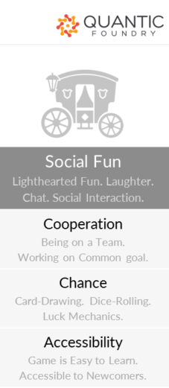
PSYCHOGRAPHIC
Name: George
Gender: Male
Age: 23
Outgoing
Lives with flatmate Ben, regularly invites friends over
Has a 9-5 job working as a painter/decorator
Watches Netflix rather than TV
Notes:
Alice

Slide 8
DEVELOPMENT
1 liar – 2 liars
Voting system – Hidden or not
Card categories – Random or chosen
Scoring
2 liars working as a team
Bonus points at the end of a round
Hint cards for liars
Notes:
Beth

Slide 9
PROJECT GOALS
Iteration & Bug Fixing – Play Testing Cycle
Theme for the game
Artwork for each card
Variety of questions, different categories
Notes:
Beth

Slide 10
PLAY TEST FEEDBACK
What they didn’t like -
Scoring and voting system was messy
Some questions are hard to lie about and no replayability
Some questions too personal
What they liked -
Round length is good – 4-12 minutes
Social interaction with friends
2 liars more interesting than 1 in a bigger group
Choice of question categories

Slide 11
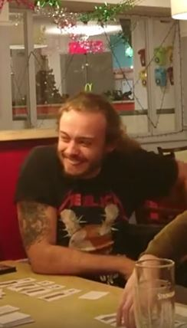
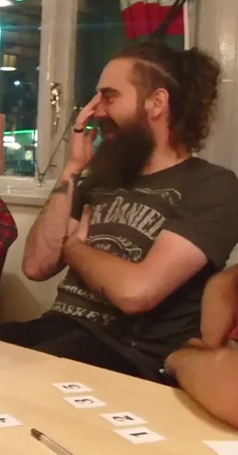
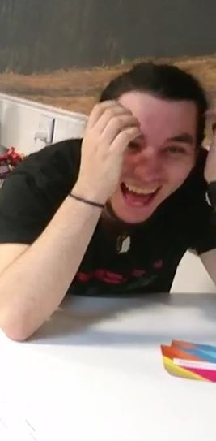
THANKS FOR LISTENING! ANY QUESTIONS?
Notes:
Beth

